Slide 1
2021 Shellfish Aquaculture Conditions of Licence
27 April 2021
CVRD Board Meeting
Web-Based Meeting

Slide 2
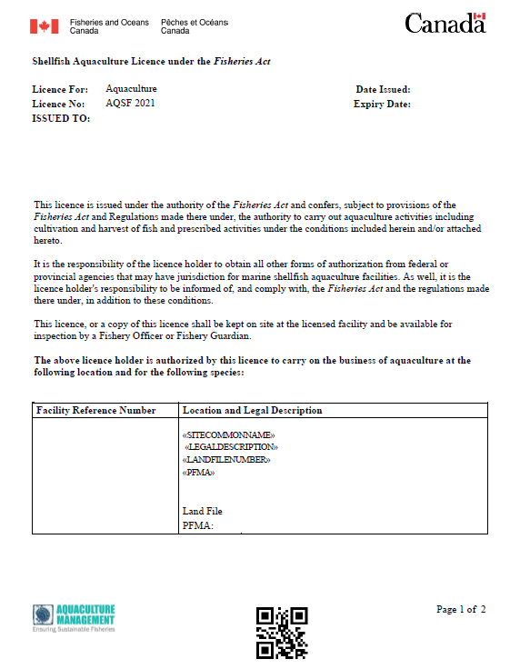
2021 Conditions of Licence Reissuance
DFO Shellfish Aquaculture licences expire April 30, 2025
DFO may change conditions of licence prior to expiry due to concerns relating to the conservation and protection of wild fish.
Recent evidence from investigations indicates significant quantities of illegally harvested bivalves are being laundered though aquaculture facilities.
Revised Conditions of Licence (COL):
Effective April 1, 2021 – April 30, 2025

Slide 3
Conditions of Licence - Priority Considerations
Address key gaps and areas of non-compliance related to bivalve traceability
Correct errors, improve clarity and enforceability
Clarity around avoidance/ protection of sensitive habitats
Align with the restored Fisheries Act, the Fish and Fish Habitat Protection Program, Ministerial Mandate letter, G7 Ocean Plastics Charter commitments, consultants report on plastic debris within the shellfish industry, national initiatives on lost / abandoned / discarded gear, and plastics reduction, etc.
Requirements for identifying gear associated with aquaculture facilities
Leverage science, research and monitoring
Data management, analysis and reporting

Slide 4
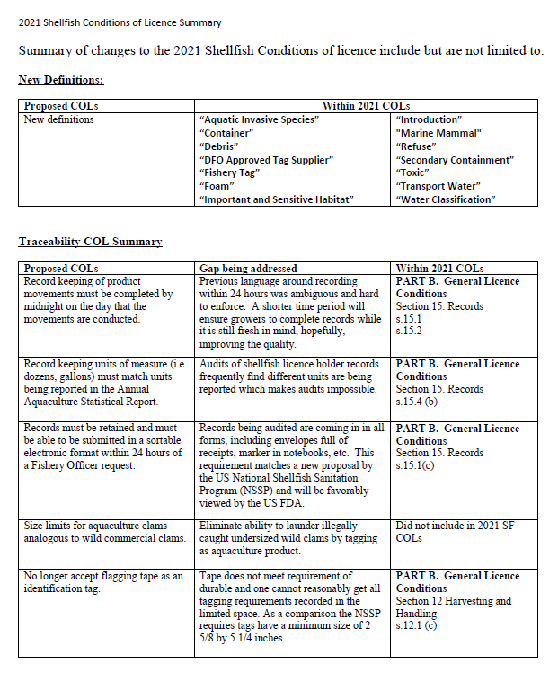
Summary
2021 Shellfish Conditions
and
Summary Table of Changes

Slide 5
Traceability
Considerations:
Address key gaps and areas of non-compliance related to bivalve traceability
Focus on tagging, record keeping, statistical reporting, sales of harvested product to buyers/receivers, landings at federally licensed processing facilities
Notable Changes made in 2021 COLs:
More stringent and clarified tagging and record keeping requirements
No selling of harvested aquaculture product to buyers, unless they are a licensed processing facility or affiliated with one
No wet storage of harvested product off of the licensed area prior to being brought to a licensed processing facility
Requirements to produce shellfish aquaculture records of product movements in an electronic and sortable format within 24 hours
electronic record keeping in sortable format to track product movements

Slide 6
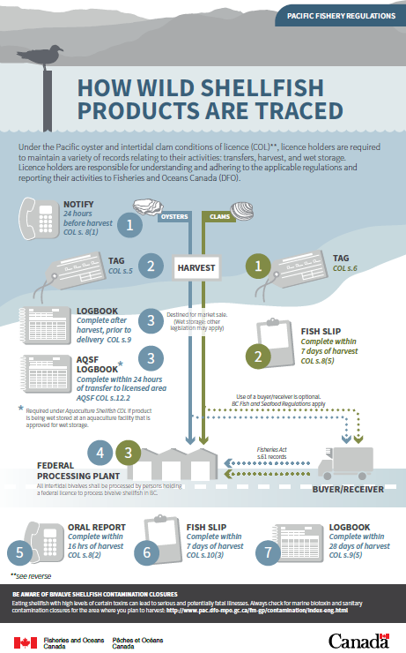
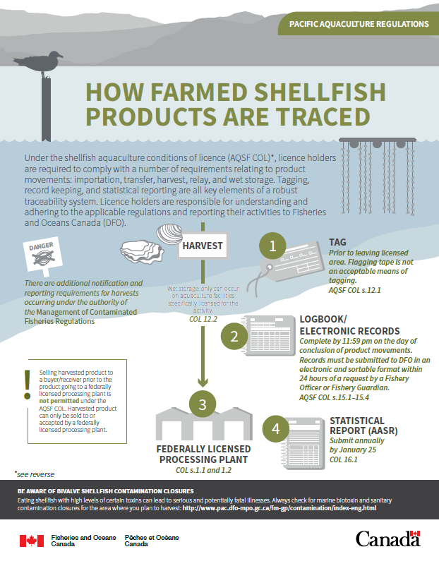
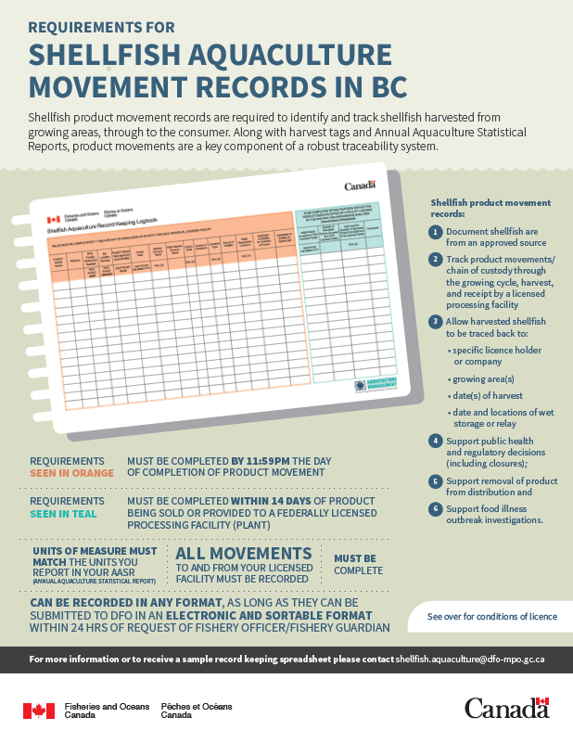
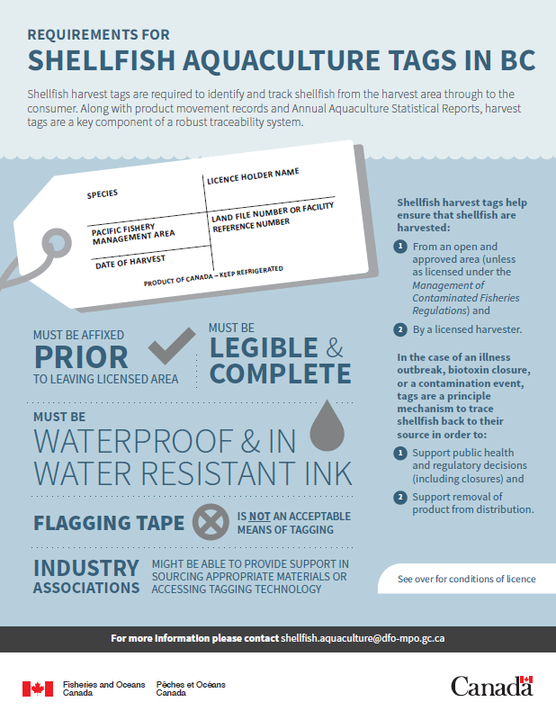
How wild harvest and harvest of farmed bivalves products are traced
New DFO Traceability Infographics
Record keeping and Tagging

Slide 7
Transfers and Aquatic Invasive Species
Considerations:
Align with the Aquatic Invasive Species Regulations and management measures / requirements
Clarifying AIS restriction areas
Cleaning/rinsing requirements to minimize AIS into marine waters
Incorporate recent science advice and recommendations
Notable Changes made in 2021 COLs:
New definitions
Clarified language on movement of bivalves and minimizing the spread of AIS
2021 COLs did not change AIS requirements. Stayed within specific PFMAs
Science Branch would like more time to do analysis of proposed expanded PFMAs, additional cleaning requirements, etc.
Will engage and consult on AIS changes during the 2025 re-issuance

Slide 8
Fish and Fish Habitat Protection
Key areas needing improvement include:
Foam Containment
Securing of Gear
Predator Netting / Use of Rebar
Avoidance of Sensitive Habitat
Notable Changes made in 2021 COLs:
New definitions
Phased approaches to minimize the impact for implementation and balance costs related to the changes:
annual sea floor inspections and clean-up starting in April 2022
prohibiting the installation of foam for floatation after April 2023
gear marking starting in April 2023
Marine Mammal (Sea Lion) interactions / mitigation requirements. Must not cause harm to sea lions, list of examples provided in Appendix
Marine Mammal Mitigation and Deterrents
Gear Marking / Identification
Improved Record Keeping, and Reporting
Seafloor Clean-Up (deepwater and subtidal)

Slide 9
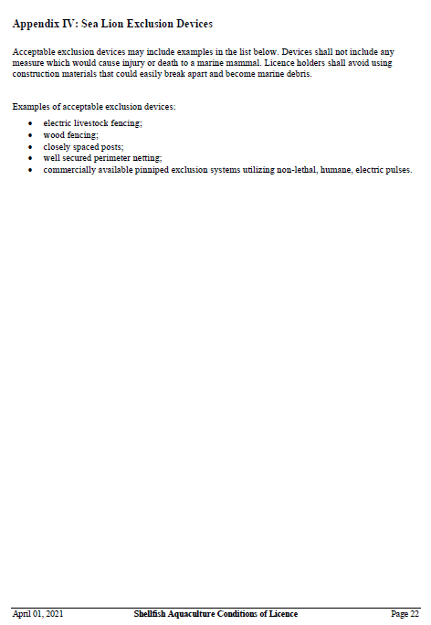
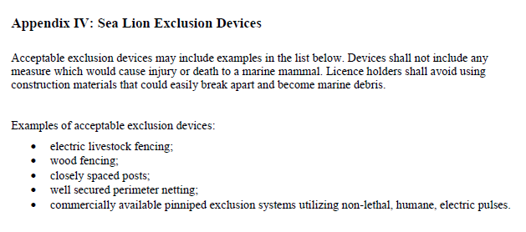
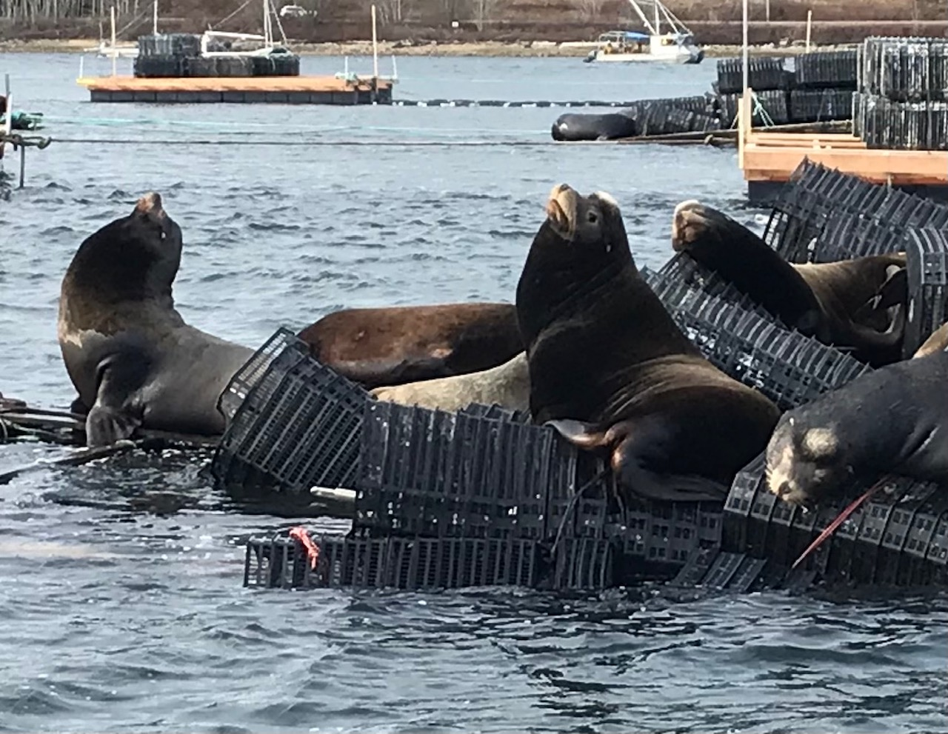
Fish and Fish Habitat Protection

Slide 10
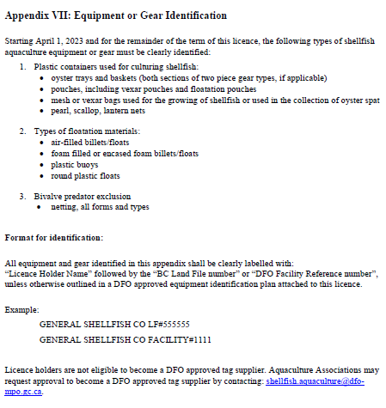
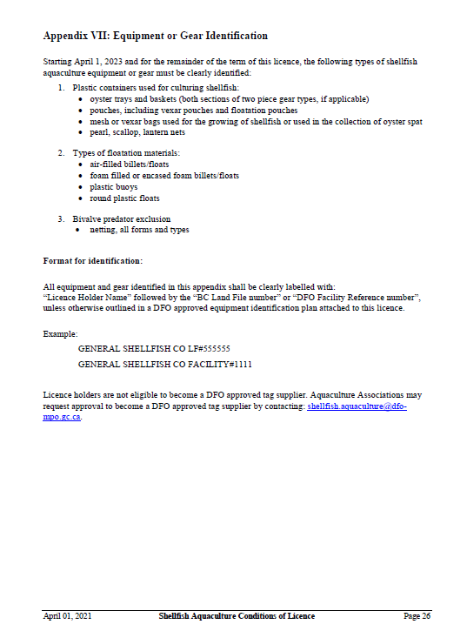
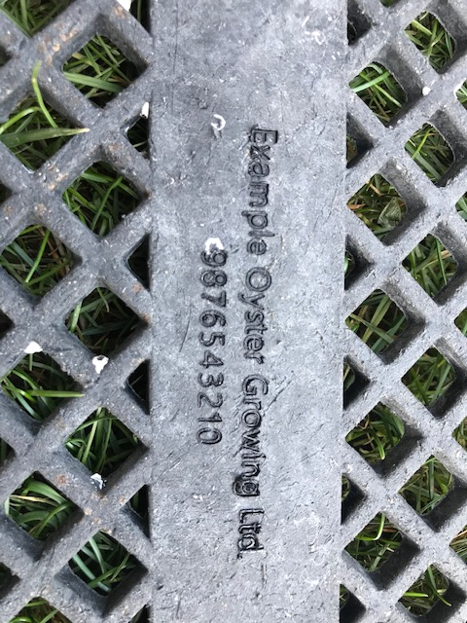
** NOTE: These photos represent what a customized basic branding iron can do. These are NOT examples showing the full gear branding requirements.

Slide 11
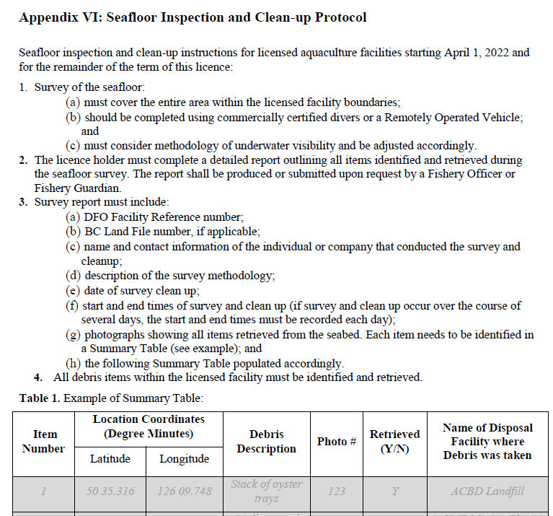
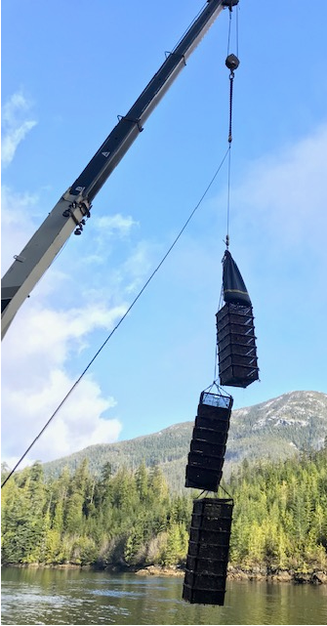
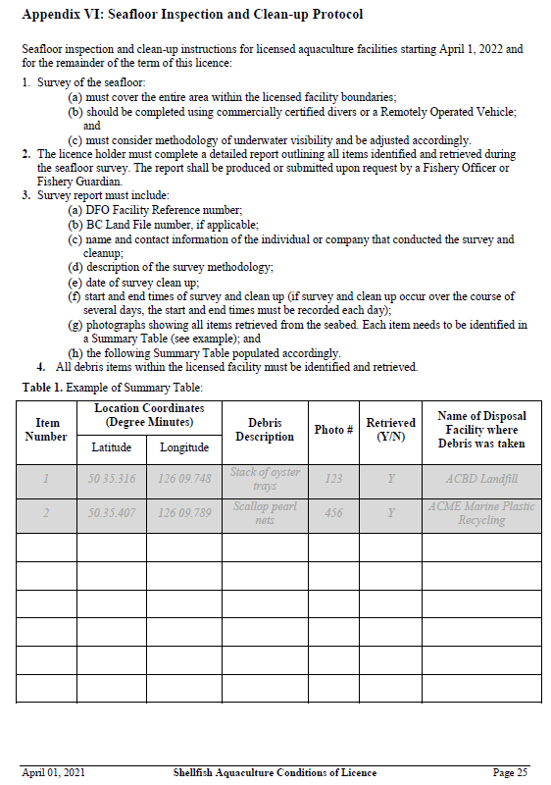

Slide 12
Comments and Feedback
please contact: shellfish.aquaculture@dfo-mpo.gc.ca

